Slide 1
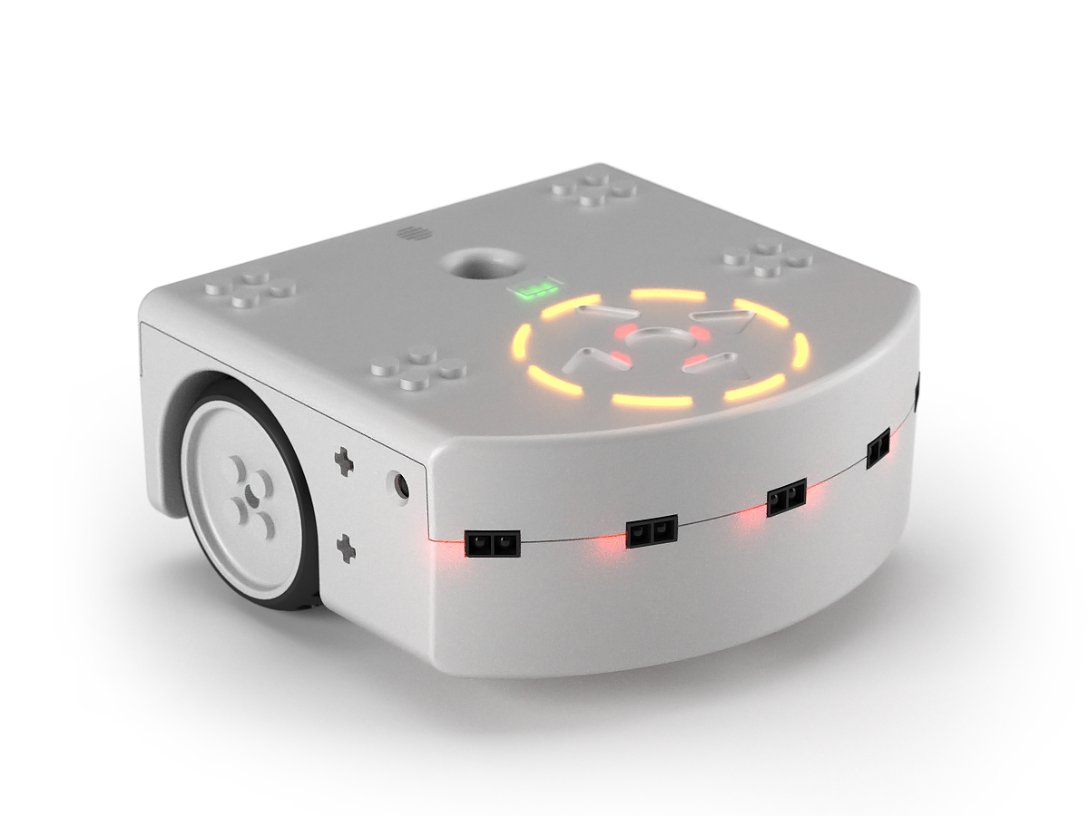
MICRO-452 Basics of mobile robotics
Project presentation
December 2021
Group 38
Tom Mery 297217 Lola Vegeas 301582 Jean Decroux 302762 Ramy Charfeddine 295758

Slide 2
Purpose of the project
The purpose of this project is to get the Thymio to go from a random starting position to a chosen goal position through an environment composed of fixed obstacles. The robot should also be able to avoid collision with any unexpected obstacle during its motion.

Slide 3
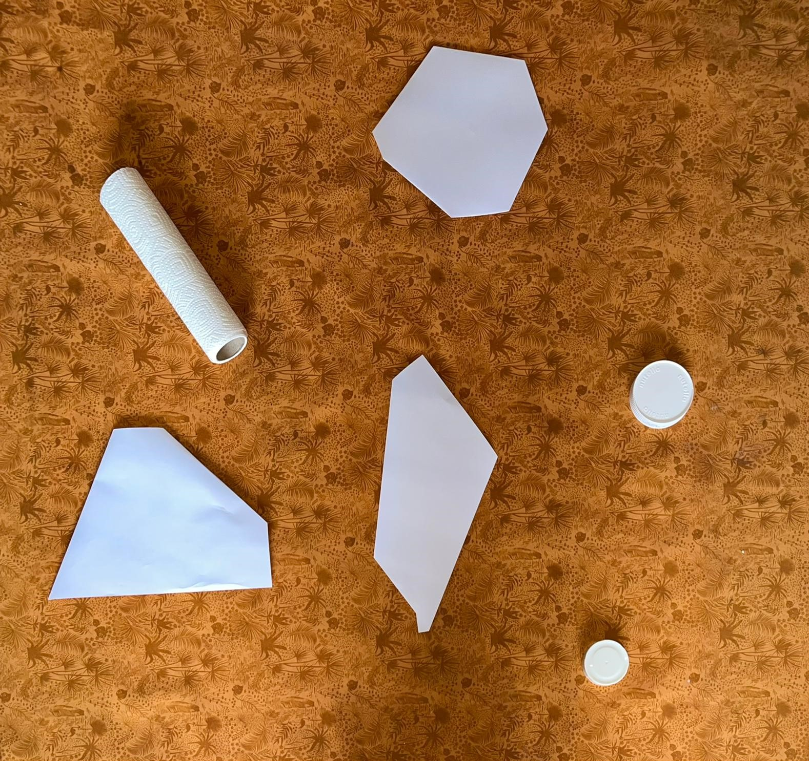
Environment and main assumptions
Uniform colored background.
Fixed obstacles must all be of the same color and their color must be far enough from the average color of the background.
Camera placed above the environment to find the fixed obstacles and track the Thymio in real time.

Slide 4
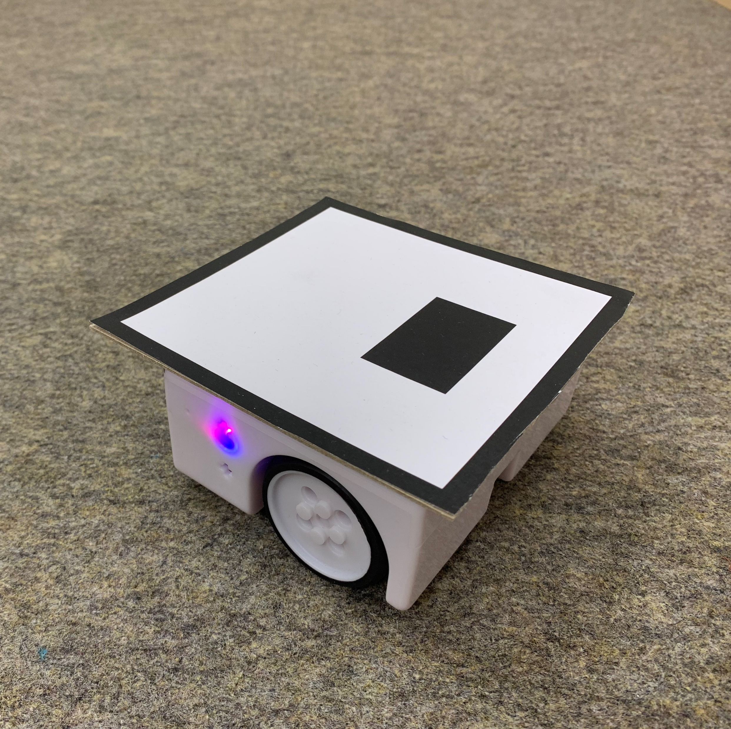
Thymio surface for the camera-based image processing
Characteristics: uniform top surface with exactly one geometrical shape inside its contours
Coordinates of the robot: coordinates of the center of the white surface
Direction and angle: based on a vector going from the center of the blue shape to the center of the Thymio

Slide 5
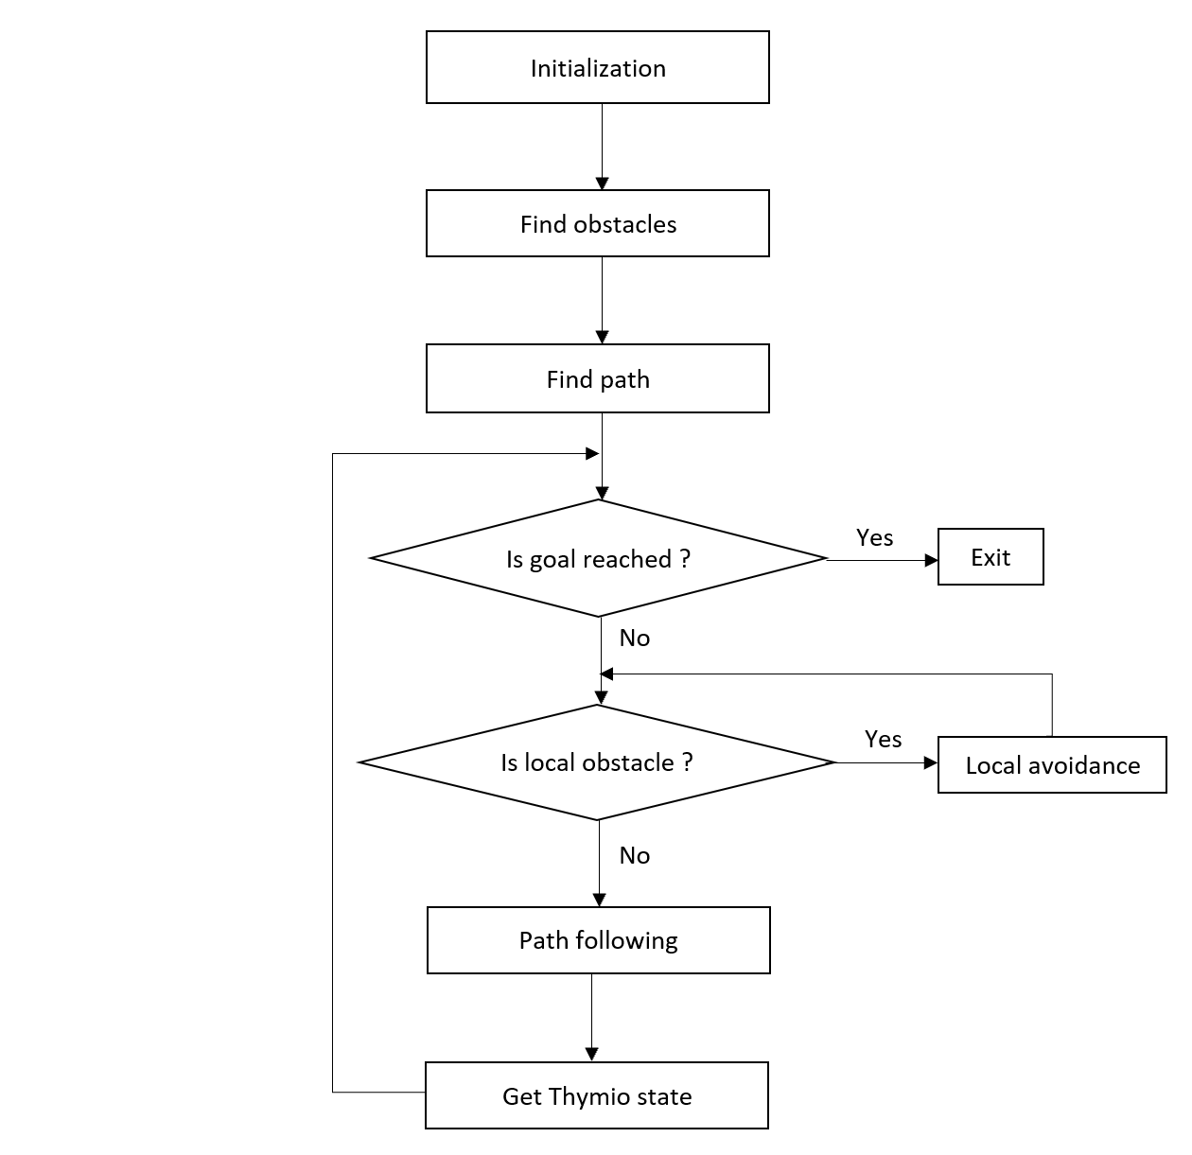
Simplified state diagram
find_obstacles
Dijkstra Algorithm
Shortest path from start to goal
Delivers nodes of the optimal path
Astolfi Controller
Based on propotional control
Objective: follow path lines and reach goal
Extended Kalman Filter
Prediction step
Correction step based on camera measurements
Notes:
From the first frame find_obstacles return a list of polygon that described the fixed obstacles. They are expended by half the swidth of the Thymio. From this list of obstacles a Visibility graph is built on order to find the shortest path.

Slide 6

Let the show begin..

